Slide 1

MIWP 2021-2024 – Action 2.3.1 Sub-group 2.3.1 meeting
IOS
March 24, 2022
Notes:
Resources in SDIs/data spaces shall evolve over time
there might be bugs to be solved
there might be new use cases requiring changes
INSPIRE artefacts are no exception!
UML models
XSD application schemas
Technical Guidance documents (TG)
Implementing Rules (IR)
A clear governance process for the maintenance and update of those artefacts is needed:
Who can ask for changes and how? Who shall endorse changes and how? How frequently are changes made?

Slide 2
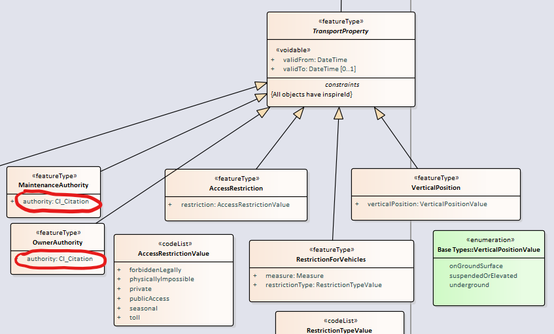
#60 TN_MaintenanceAuthority-OwnerAuthority_CI_Citation not matching
Change proposal:
  Change the type used for MaintenanceAuthority.authority and OwnerAuthority.authority from gmd:CI_Citation to CI_ResponsibleParty

Slide 3
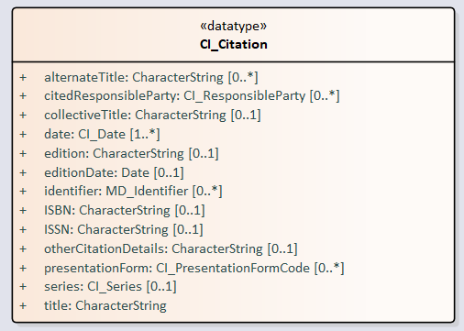
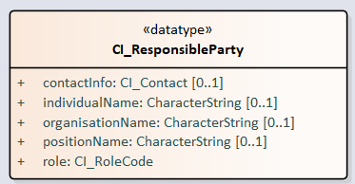
#60 TN_MaintenanceAuthority-OwnerAuthority_CI_Citation not matching
Issue faced:
  The type used for the attributes does not match their description.
The two attributes mentioned (defined as "Identification of the maintenance authority." and "Identification of the owning authority.") are currently using gmd:CI_Citation (defined as "standardized resource reference") as type.
The attributes should use CI_ResponsibleParty (defined as "identification of, and means of communication with, person(s) and organizations associated with the dataset")

Slide 4
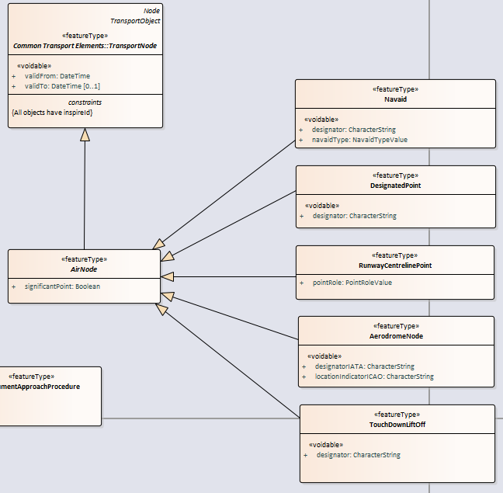
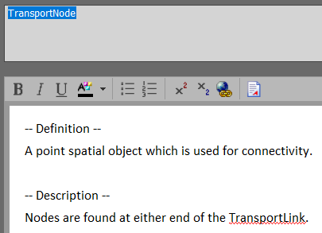
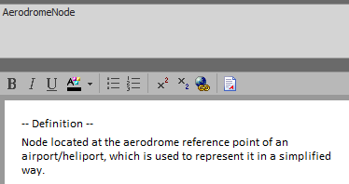
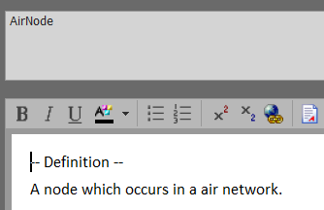



#61 TN-A_Nodes_inherit from TransportPoint instead of TransportNode
Change proposal:
The three feature types AerodromeNode, DesignatedPoint and RunwayCentrelinePoint should inherit from TransportPoint instead of TransportNode.
Issue faced:
The three types are currently inheriting from TransportNode. That means that they shall theoretically only be present where transport links connect or end. This is not the case in reality and the model should therefore be adapted.

Slide 5
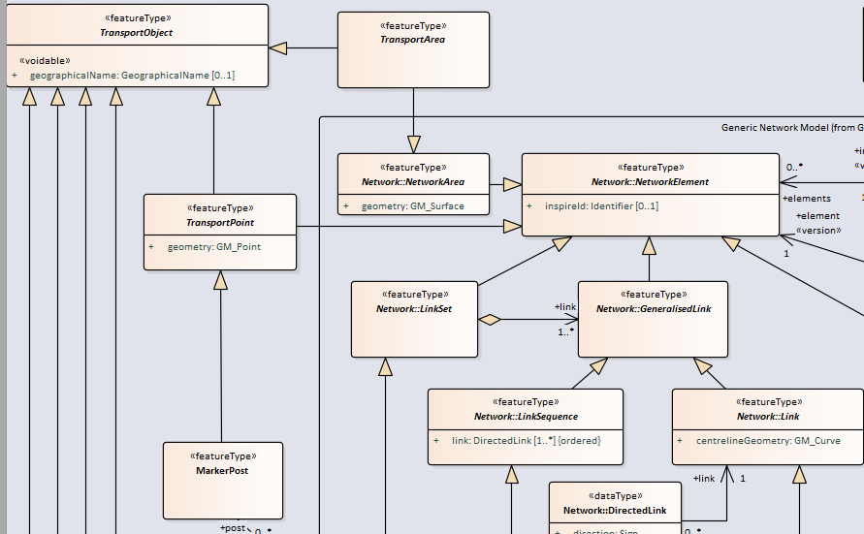
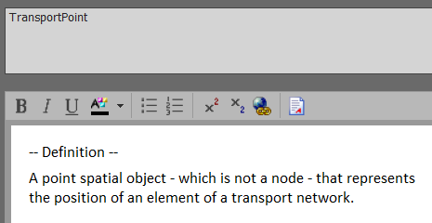

#61 TN-A_Nodes_inherit from TransportPoint instead of TransportNode

Slide 6

Thank you!
aaaa
© European Union 2020
Unless otherwise noted the reuse of this presentation is authorised under the CC BY 4.0 license. For any use or reproduction of elements that are not owned by the EU, permission may need to be sought directly from the respective right holders.

Slide 7





Keep in touch
EU Science Hub: ec.europa.eu/jrc
@EU_ScienceHub
EU Science Hub – Joint Research Centre
EU Science, Research and Innovation
Eu Science Hub
Notes:
Delete/update as appropriate

